Slide 1
Risk & Ambiguity Task
This is one of the decision-making tasks you will be asked to do. Remember that your bonus could come from this task so each and every choice you make today is important!

Slide 2
In this task, you will be asked to make different economic choices.
In the ”gain” portion of the task, each question will ask you to choose between receiving a certain, smaller amount of money OR playing a lottery for a chance to win a larger amount.
In the ”loss” portion of the task, each question will ask you to choose between losing a certain amount of money OR playing a lottery for a chance to lose another (lesser) amount.

Slide 3
Understanding lottery display

Slide 4
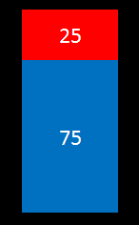
This is what the “lottery” will look like.
$0
$20

Slide 5
Each lottery is actually a bag with 100 poker chips (some red and some blue).
The size of the red and blue parts and the numbers written inside them tell you how many red and blue chips are in the bag.
In this bag most chips are blue (75 out of 100) and fewer are red (25 out of 100).
$0
# of chips in
this bag
$20

Slide 6
If you put your hand in this bag and pull out one chip at random, you would be more likely to get a blue chip than a red chip since there are more blue chips than red chips.
We call the process of putting your hand in the bag and pulling out a chip “playing the lottery”.
$0
# of chips in
this bag
$20

Slide 7
Why should you care which color chip you pull out?
Because each chip is worth some money.
You know how much each chip is worth by the dollar amount next to each color.
If you chose to play this lottery and pulled out a blue chip, you get $20. If you pulled out a red chip you get $0.
$0
amount of $ you could win
$20

Slide 8
For each lottery, one color will be worth $0 and the other color will be worth more.
Half the time blue will be worth more and the other half the time red will be worth more.
$0
$20
$20
$0

Slide 9
For each lottery, one color will be worth $0 and the other color will be worth more.
Half the time blue will be worth more and the other half the time red will be worth more.
$0
$20
$20
$0

Slide 10
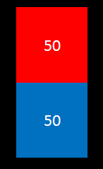
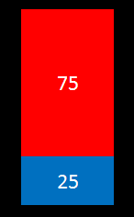
These are examples of lotteries that you could see
more red chips
more blue chips

Slide 11
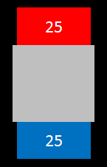
You will also see lotteries like this one. Here, part of the bag is hidden, so you only have partial information about how many of the 100 chips are red and how many are blue.
In this example, you can see that there are at least 25 blue chips and at least 25 red chips. The remaining 50 chips could be all red, all blue or any combination of red and blue.
$0
amount of hidden chips
$20

Slide 12
There could be many possible combinations of red and blue chips in the hidden part.
But the number of chips in these bags is fixed. It will not change during the experiment.
$0
amount of hidden chips
$20

Slide 13
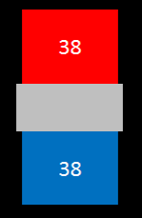

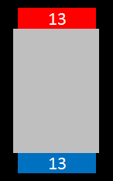
These are examples of lotteries with hidden chips you could see
more hidden chips

Slide 14
Every lottery in the task is linked to a real bag.
We have shown you some examples.
The bags will be in the room during the experiment and will not be touched.
If you wish, you can inspect the content of each bag after all study visits have been completed.

Slide 15
Understanding the task

Slide 16
You will answer many questions. Each question will ask you to choose between a certain gain (or loss) or playing the lottery. The lottery bag and the amount of money you could win (or lose) will be different for each question.
Your options will be presented this way:

Slide 17
This is how the task display will look like
$20
$5
$0

Slide 18
The lottery will appear in the center of the screen. The certain amount will be presented on either the right or left side of the bag.
$20
$5
$0

Slide 19

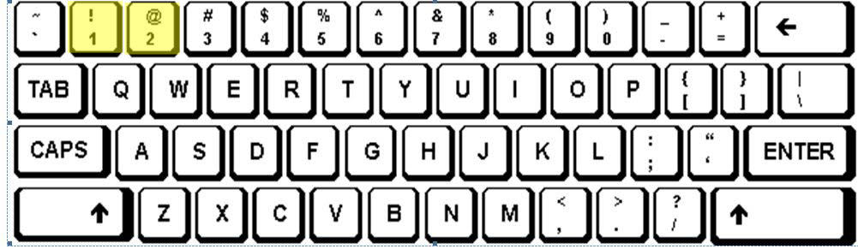
When the green circle appears, use the number keys at the top of the keyboard to indicate your choice
Press 1 to select the left option
Press 2 to select the right option

Slide 20
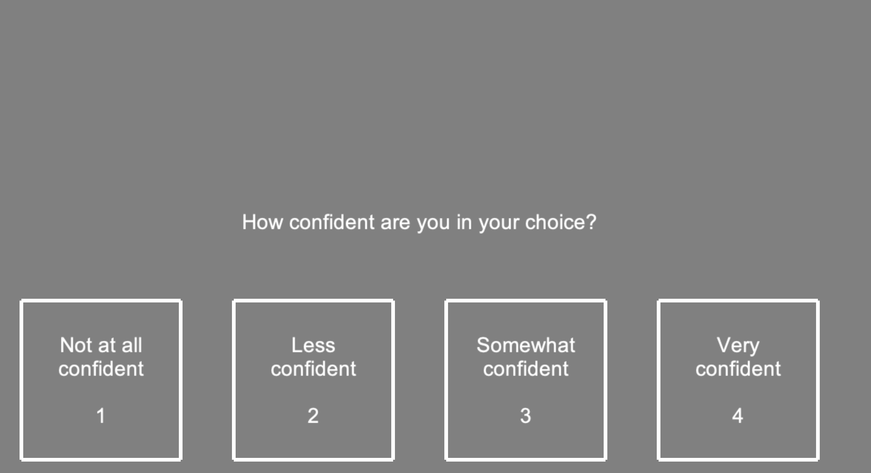
After selecting an option, you will be asked how confident you are that you made the best decision for yourself.

Slide 21
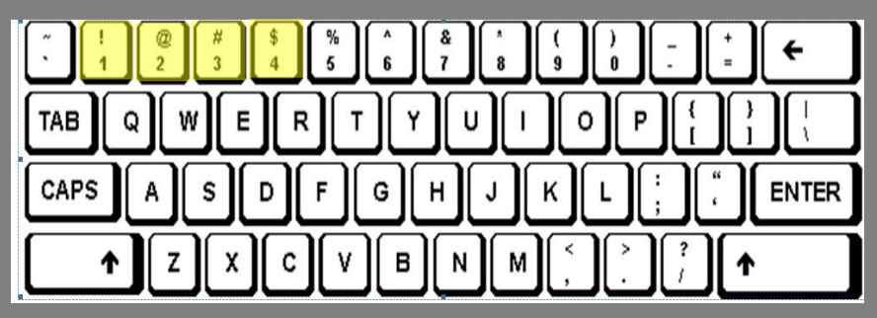
After each choice, you will be asked to rate the confidence in the choice you made. 1 indicates you can’t decide which option you prefer and just guessed, while 4 indicates total certainty in your selection. You will use the number keys at the top of the keyboard.
Press 1 –Not at all confident
Press 2 –Less confident
Press 3 –Somewhat confident
Press 4 –Very confident

Slide 22
Understanding payment

Slide 23
Make sure you choose carefully each time! If this task is chosen for your bonus, only one of the choices you make will count. This one choice will determine your bonus.
This means you should always choose the option you prefer.

Slide 24
You will start the task with an automatic $50 “endowment”. Your bonus will be added to or subtracted from that amount.
At the end of the task, a trial will be randomly selected.
If in the randomly selected trial you chose the certain gain (or loss) of $5, you would receive (or lose) $5 from your endowment. If you selected the lottery, you would play the lottery that was offered (by pulling out one chip).

Slide 25
Please, remain engaged throughout the experiment and provide earnest, sincere responses for each trial. Remember, if this task is selected as your bonus, your choices could help you walk away with an additional bonus ranging from $0 to $100, depending on the selected earnings trial.

Slide 26
Questions?

Slide 27
Suppose this task and trial were randomly selected at the end and you chose the option on the LEFT. How much bonus would you get?
$0
$5
$34

Slide 28
Suppose this task and trial were randomly selected at the end and you chose the option on the LEFT. How much bonus would you get?
$0
$5
$34
The correct answer is: $5 added to your endowment

Slide 29
How about if you chose the option on the RIGHT?
$0
$5
$34

Slide 30
How about if you chose the option on the RIGHT?
$0
$5
$34
The correct answer is: You would have to play this lottery to find out. If you pull out a blue chip, you will get $34 added to your endowment. If you pull out a red chip, you will get $0 added to your endowment.

Slide 31
Now suppose this trial was randomly selected at the end and you chose the option on the LEFT. How much bonus would you get?
$0
-$5
-$20

Slide 32
Now suppose this trial was randomly selected at the end and you chose the option on the LEFT. How much bonus would you get?
$0
-$5
-$20
The correct answer is: $5 subtracted to your endowment

Slide 33
Now how about if you chose the option on the RIGHT?
$0
-$5
-$20

Slide 34
Now how about if you chose the option on the RIGHT?
$0
-$5
-$20
The correct answer is: You would have to play this lottery to find out. If you pull out a blue chip, you would get $20 subtracted from your endowment. If you pull out a red chip, you would get $0 subtracted from your endowment.

Slide 35
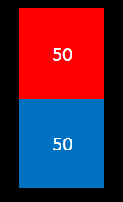
From which lottery are you more likely to pull out a blue chip? LEFT or RIGHT?
$0
-$20
-$50
$0

Slide 36
From which lottery are you more likely to pull out a blue chip? LEFT or RIGHT?
$0
-$20
-$50
$0
The correct answer is: RIGHT

Slide 37
From which lottery are you more likely to get $0? LEFT or RIGHT?
$0
$20
$50
$0

Slide 38
From which lottery are you more likely to get $0? LEFT or RIGHT?
$0
$20
$50
$0
The correct answer is: RIGHT

Slide 39

From which lottery are you more likely to pull out a red chip? LEFT or RIGHT?
$28
$12
$0
$0

Slide 40
From which lottery are you more likely to pull out a red chip? LEFT or RIGHT?
$28
$12
$0
$0
The correct answer is: RIGHT

